Slide 1

Stock Market prediction
Final Project

Slide 2

Group Members
Amanda Cantu
Jamie Hutton
Carlos Valenciano
Adam Saenz

Slide 3

Introduction
In the dynamic world of financial markets, informed decision-making is paramount. Harnessing the capabilities of machine learning, we aim to revolutionize the stock market prediction landscape. Our focus lies in training advanced algorithms to meticulously analyze historical trends, empowering us to make strategic business decisions with confidence.

Slide 4

Objective
Our primary goal is to identify the top-performing stocks for a specific time period, leveraging the power of machine learning. By delving into the intricacies of daily price changes and percentage fluctuations, we seek to unearth valuable insights that can drive our investment strategy.

Slide 5

Methodology
We will employ two powerful machine learning frameworks, Tensorflow and Scikit-Learn, to develop and fine-tune our prediction models. By comparing their accuracies, we aim to discern the strengths and weaknesses of each, ultimately determining the most effective tool for our predictive analytics endeavors.

Slide 6
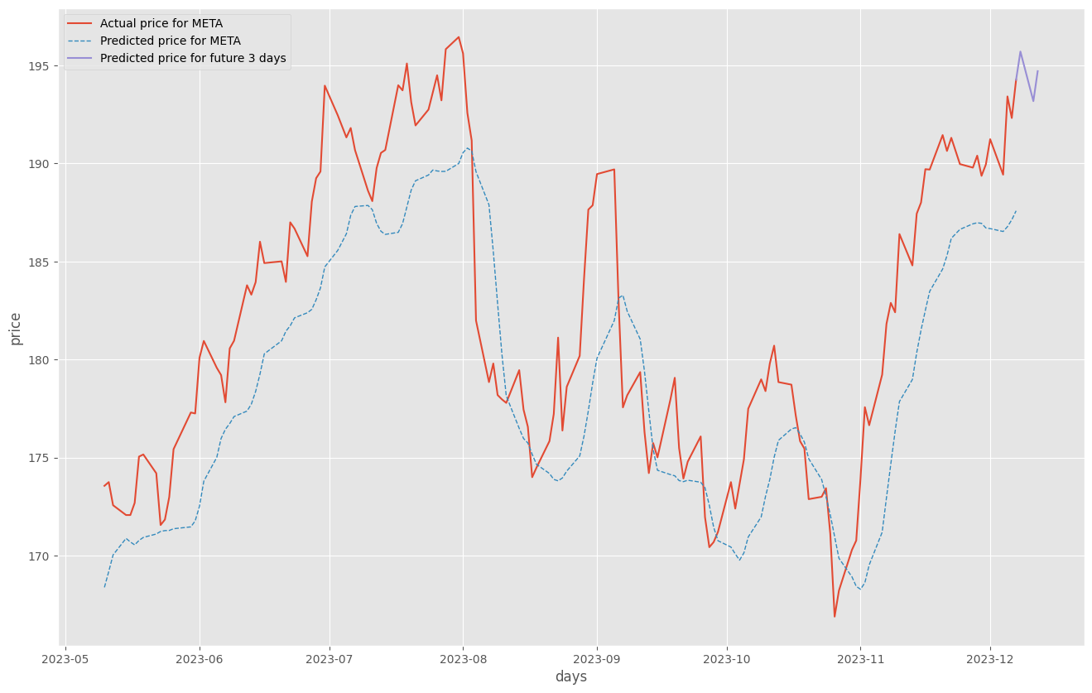
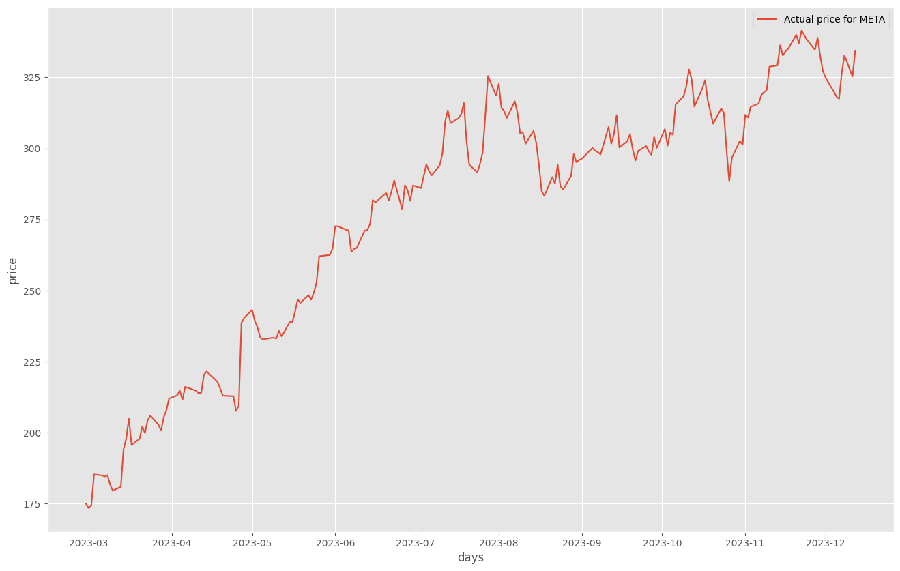
Stock Market Predictor

Slide 7
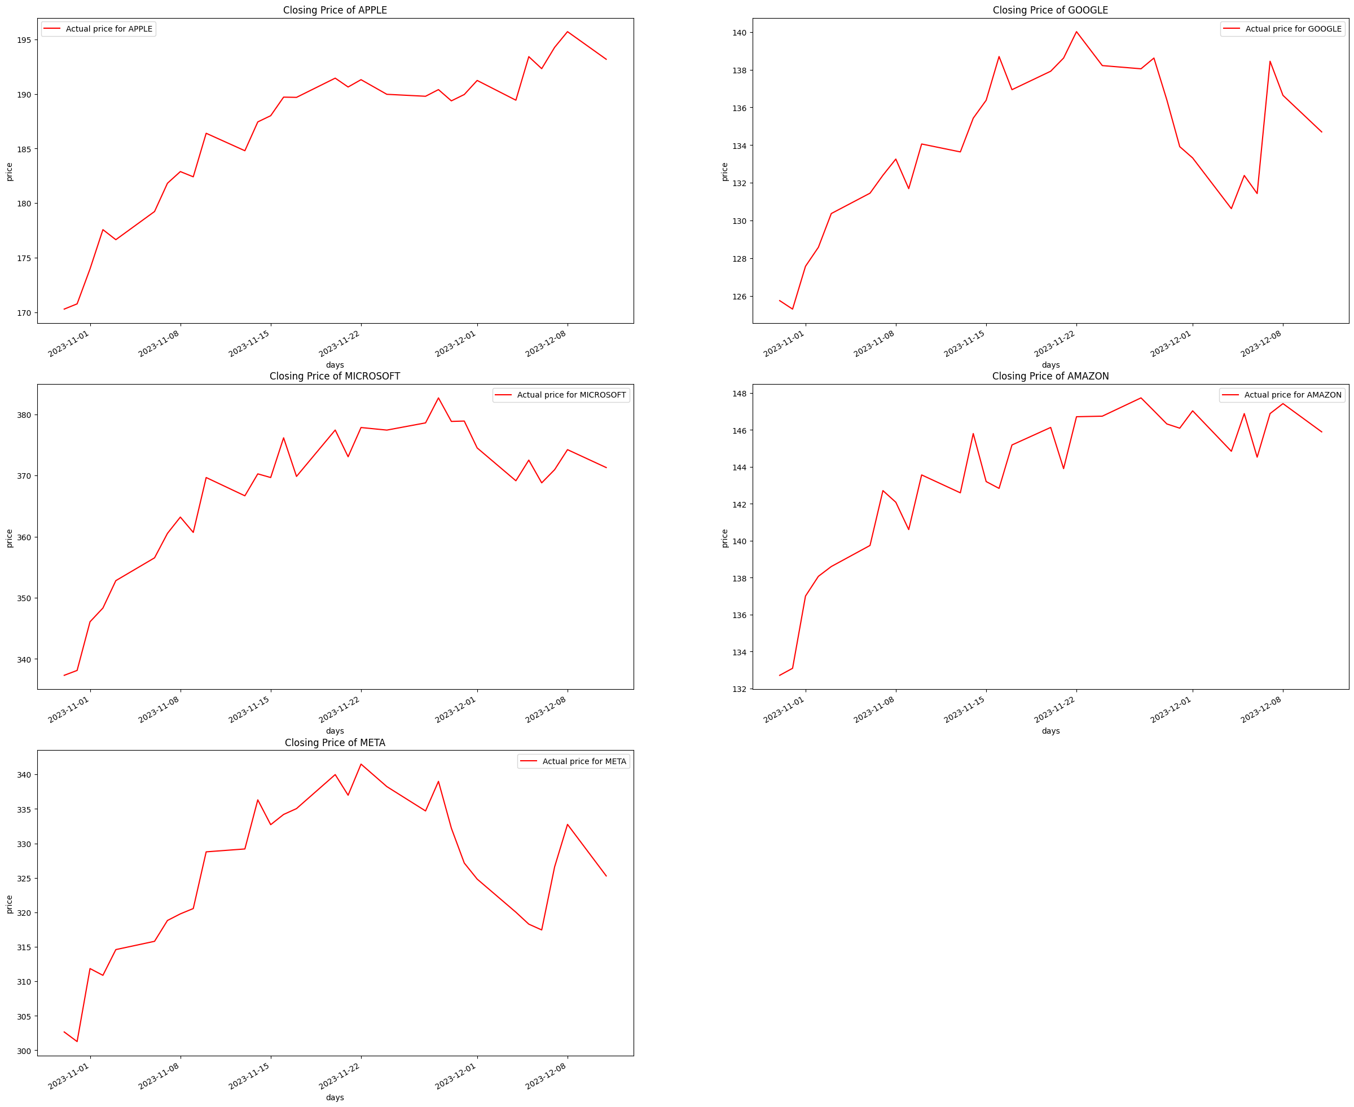
Stock Price Prediction with LSTM (Long-Short Term Memory)

Slide 8
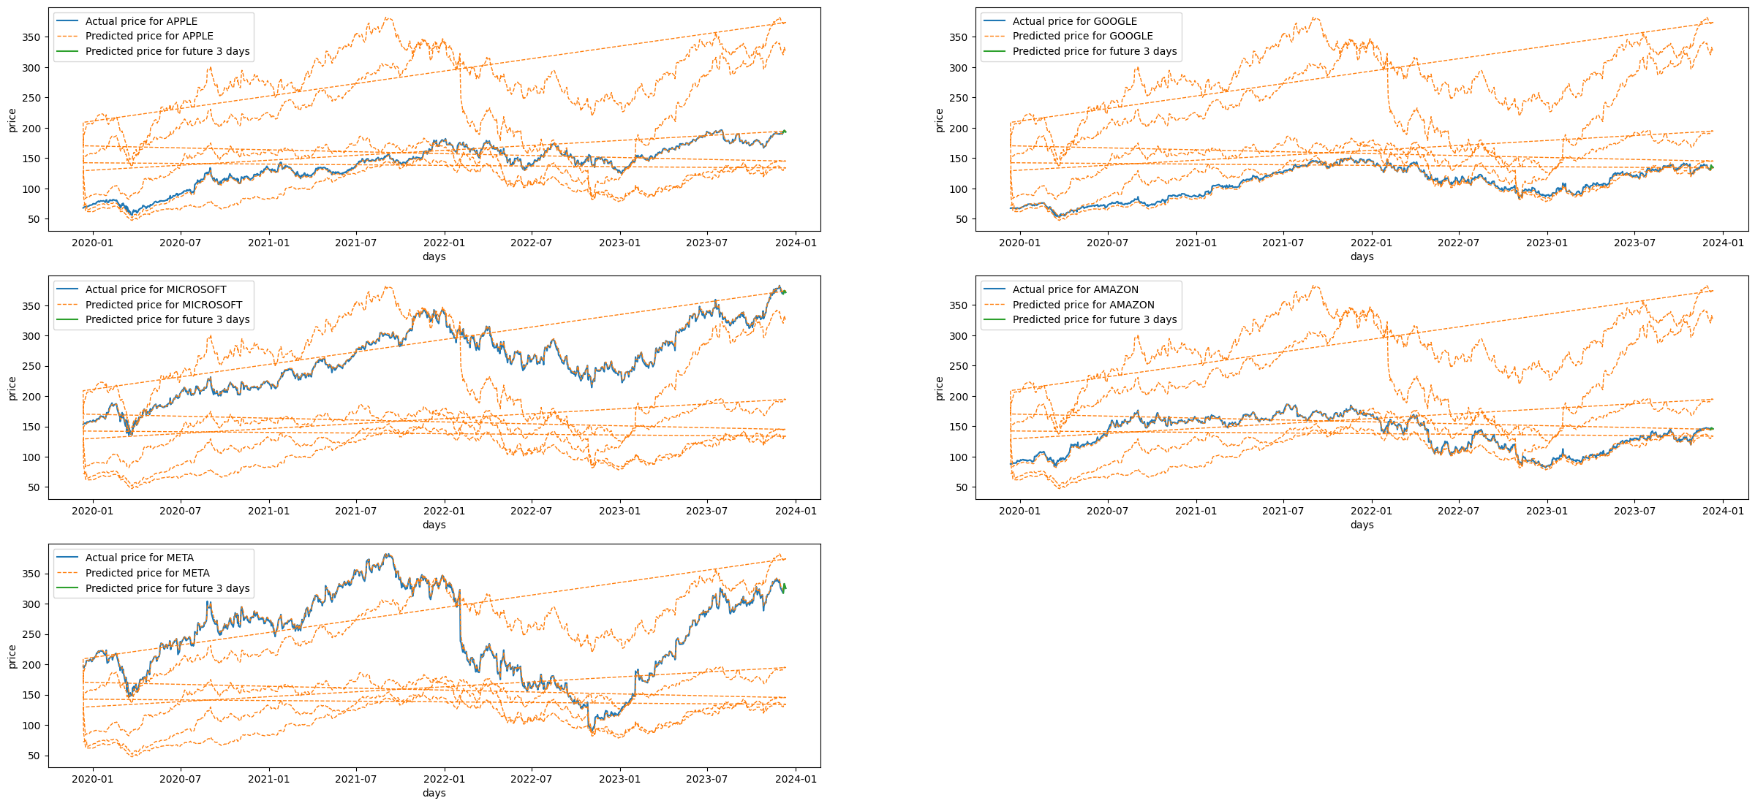
Predicted Stock Price Futures

Slide 9


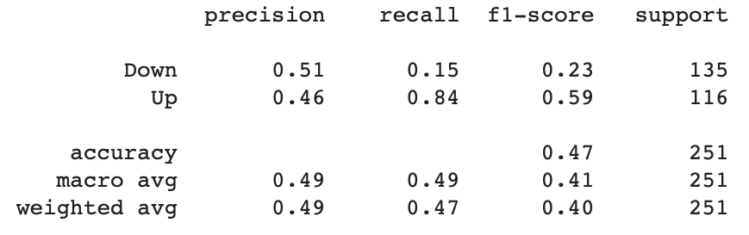
Stock Logistic Regression
Balanced Accuracy Score
Confusion Matrix
Classification Report

Slide 10
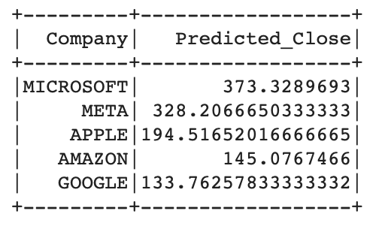
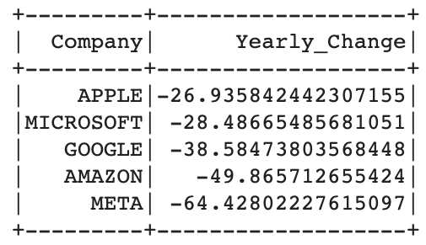
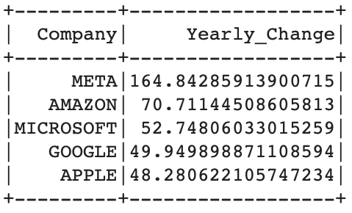
Stock Spark
Average Predicted Close for The Next Three Days
Calculated Yearly Change for 2022
Calculated Yearly Change for 2023

Slide 11
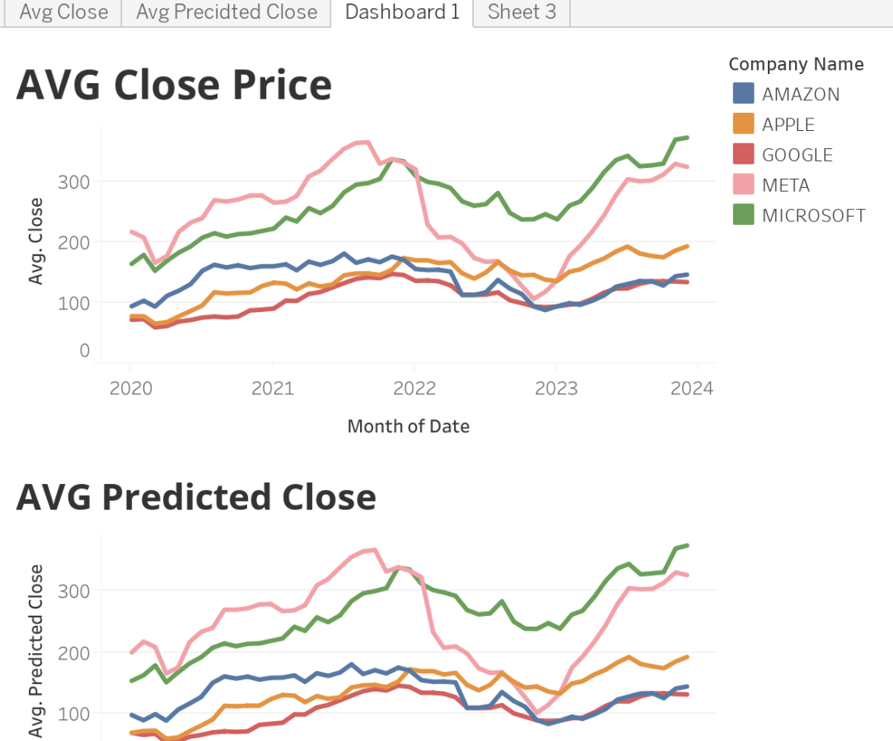
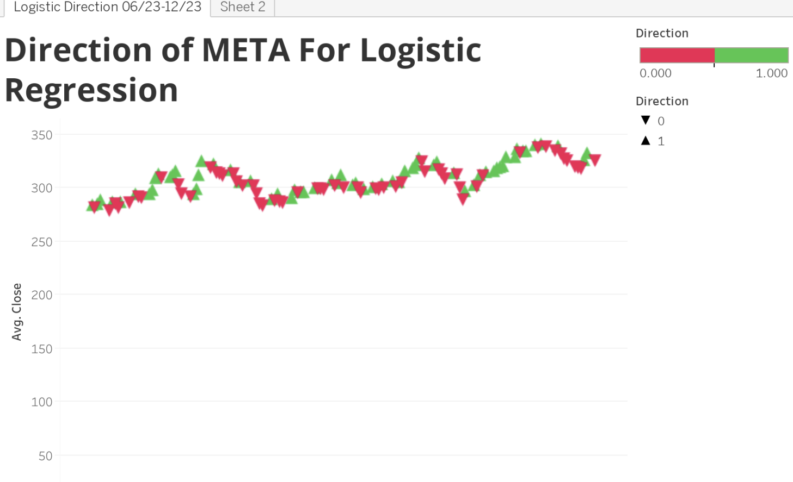
Tableau Visualizations

Slide 12

Key Components
Data Analysis: Rigorous examination of historical data to identify patterns and correlations.
Algorithm Training: Utilizing Tensorflow and Scikit-Learn to train models on past trends.
Top Stock Selection: Identifying the best five stocks poised for success during the specified time-period. In this presentation, we focus on Meta.
Daily Price and Percentage Change: Scrutinizing daily price movements and percentage changes to refine our predictions.

Slide 13
Significance
Our venture into machine learning-driven stock market predictions is not merely an exploration of cutting-edge technology but a strategic move towards precision in financial decision-making. The ability to discern the most promising stocks through a comparative analysis of Tensorflow and Scikit-Learn will equip us with valuable insights, fostering a data-driven approach to investments.

Slide 14

Conclusion
In logistic regression, the probabilities for 'Up' and 'Down' were approximately 46% and 51%, indicating an almost equal likelihood of META increasing or decreasing. The yearly change from 2022 to 2023 shifted from negative to positive. On December 12, 2023, the predicted META values for the next three days were $323.08, $323.6, and $321.54.
It's important to note that this prediction is biased as it relies solely on daily data from a single source, and a more comprehensive analysis could have been achieved by incorporating hourly data from multiple sources.
As we embark on this exciting journey at the intersection of finance and technology, our commitment is to unlock the potential of machine learning in predicting stock market trends. By embracing innovation and rigorous analysis, we aim to empower our investment decisions with unparalleled accuracy and foresight.

